Slide 1
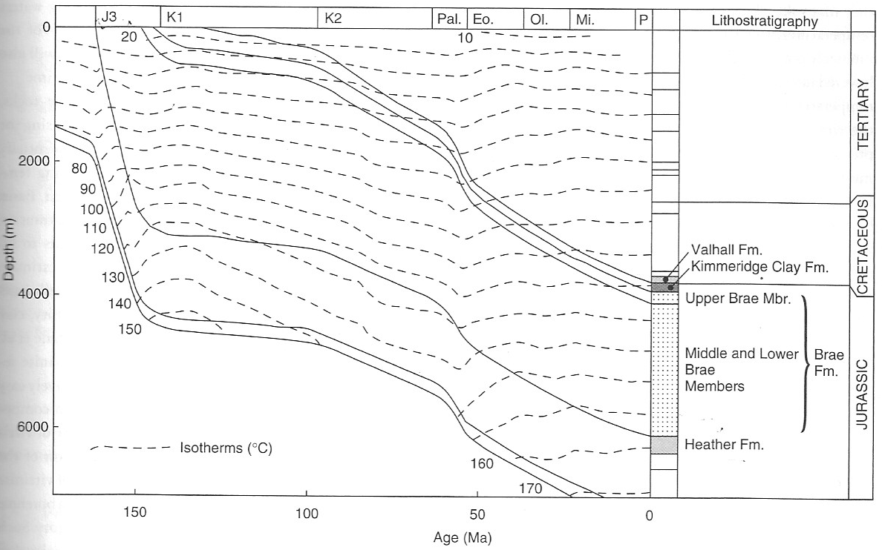
Burial graphs
We have learnt that organic-rich source rocks mature under increasing pressure and temperature as they get buried into the subsurface. In exploration for hydrocarbons, a key element is determining when and where these source rocks have reached conditions that allow maturation of organic matter – i.e. when they passed into oil and gas windows. This can be reconstructed using burial graphs that represent the depth and temperature history of a given rock column through time.
Gluyas 2004

Slide 2
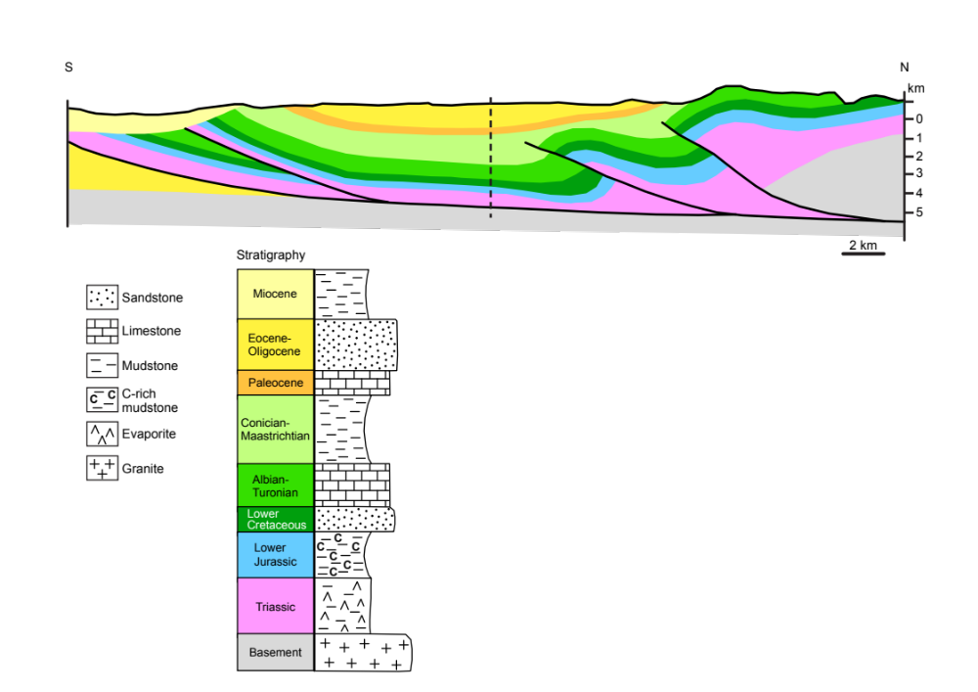
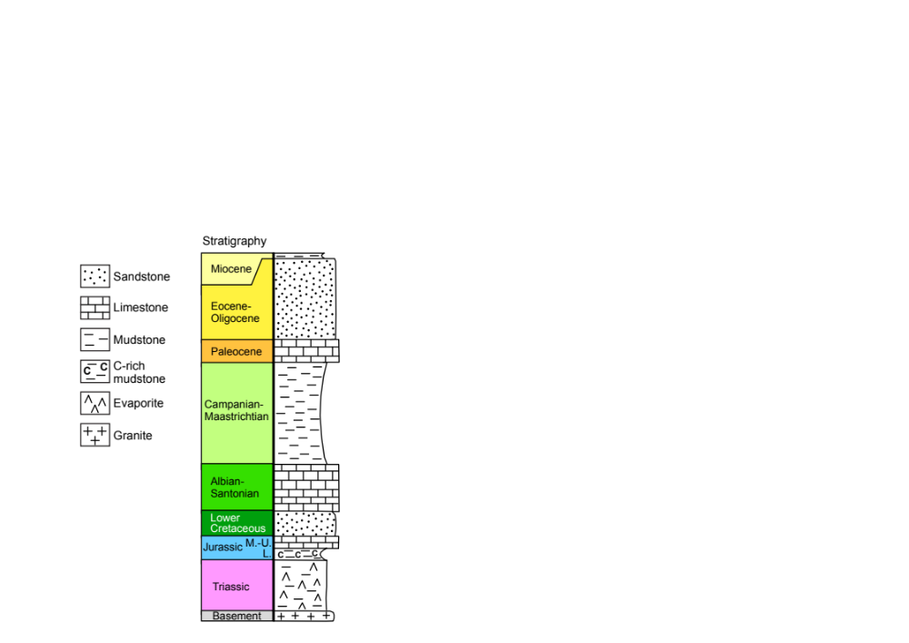
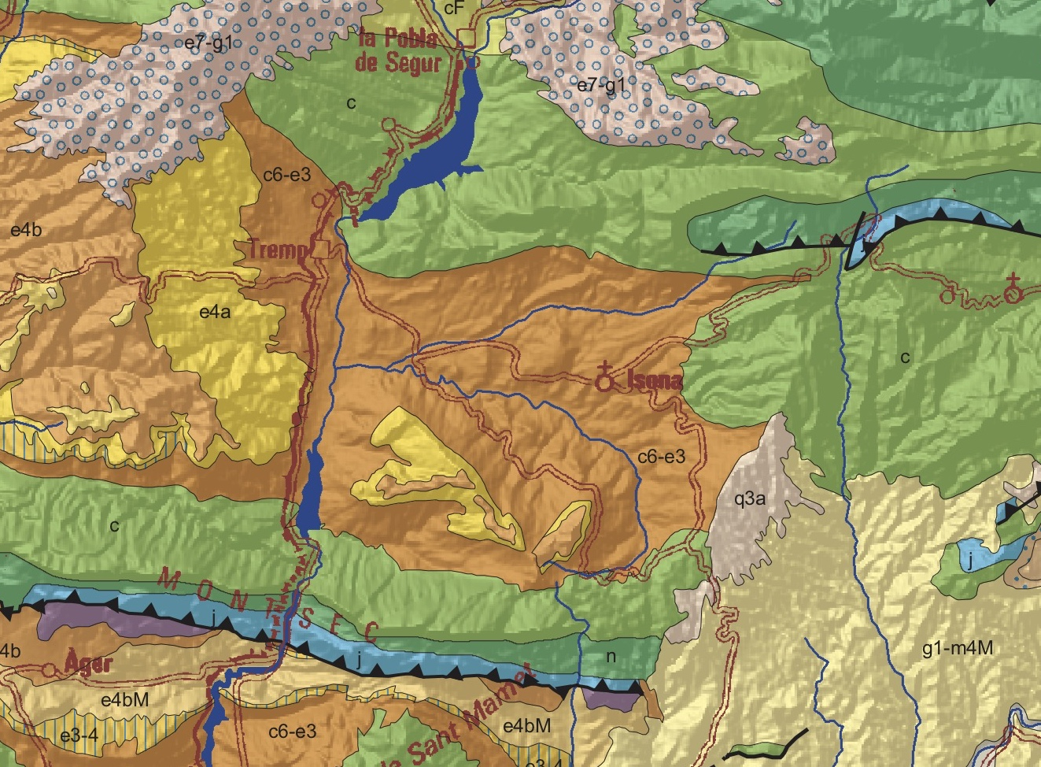
well
Geological map (colors not identical)
© IGC

Slide 3
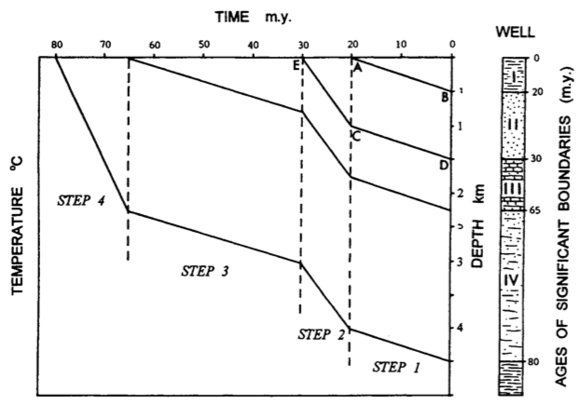
Burial graph construction
Step 1:
Starting from youngest unit (I), use its basal age (20 Myr) to determine when it was at surface -> line A-B
All units below will have the same burial rate during this time interval, so draw parallel lines (C-D etc)
Step 2:
For the next unit (II), use its basal age (30 Myr) to determine when it was at surface -> line E-C
All units below will have the same burial rate during this time interval, so draw parallel lines
Steps 3-4:
Systematically follow the same principle, working your way back in time.

Slide 4
